Slide 1

Department of Information Technology
A.P. Shah Institute of Technology
G.B.Road,Kasarvadavli, Thane(W), Mumbai-400615
UNIVERSITY OF MUMBAI
Academic Year 2019-2020

Slide 2
A Project Report on
ML Enabled Surveillance System for Societies Submitted in partial fulfillment of the degree of
Bachelor of Engineering(Sem-VIII)
in
INFORMATION TECHNOLOGY
By
Mr. Pranav Chauhan (17204004)
Mr. Sachin Gupta (17204001)
Mr. Rohit Arava (17204017)
Under the Guidance of
Dr. Sameer Nanivadekar & Prof. Vishal Badgujar

Slide 3
1.Project Conception and Initiation

Slide 4
1.1 Abstract
Today every society faces a problem of intruders and illegal vehicle parking.
Many outsiders are entertained on the premises, which can make harm to the public and can damage their property.
The register book can be easily manipulated by the intruders.
The purpose of this idea is to successfully develop a system that will detect the vehicle number plate, recognize the human faces of the residential members and as well as for the outsiders in real-time.
Our model will detect any intruder penetrating the society walls and as detected an alarm will be raised.

Slide 5
1.2 Objectives
The objective of this system is to develop an efficient and intelligent security system which everyone can afford and everyone can rely on it.
To track and monitor all the suspects On the premises and classify them and store it for further consequences.
After satisfying all these constraints the algorithm will generate the best possible log which can be understood at ease. And will be globally accepted as a benchmark for security.

Slide 6
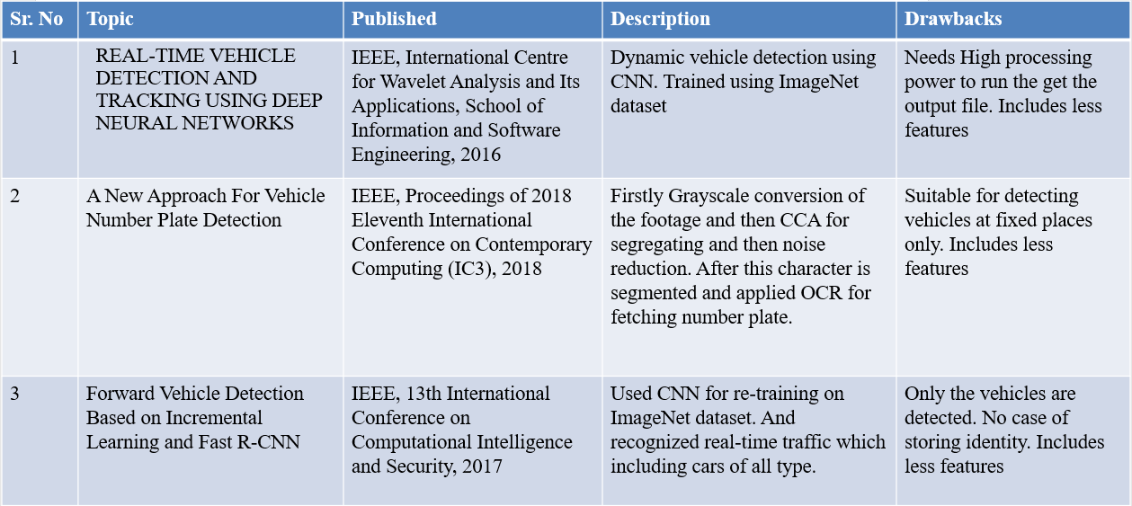
1.3 Literature Review

Slide 7
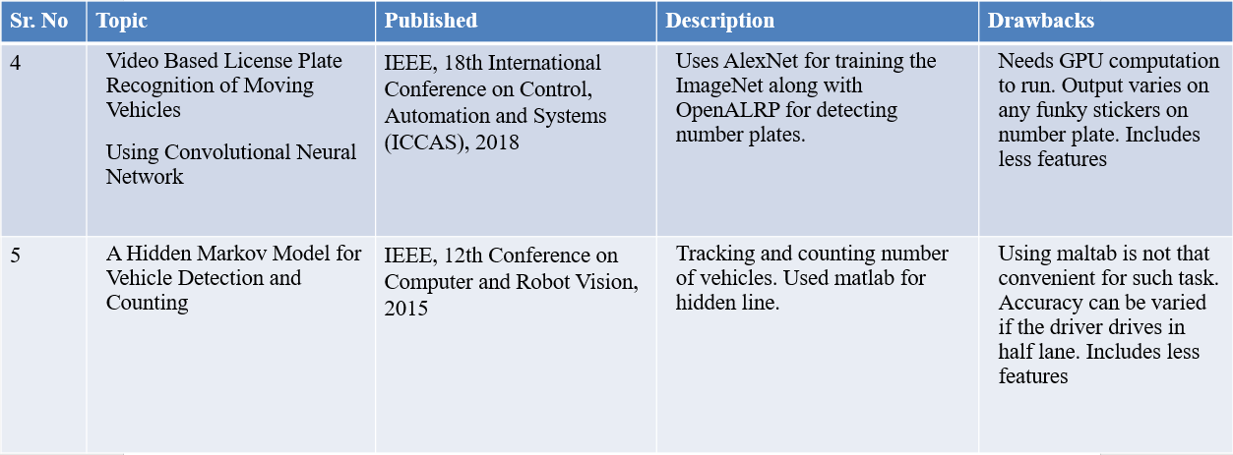

Slide 8
1.4 Problem Definition
Security is one off the major problem faced in societies
Boundaries of the society are less secure.
Many outsider/salesman enter without permission.
IN and OUT of the residential vehicle needs to be managed.
No more information of the outsider is available.
Many society face problem of illegal vehicle parking.
Current technologies that have the similar functionality are costlier and not that capable.

Slide 9
1.5 Scope of the Project
Detect residential and non-residential vehicle through vehicle number plate.
Send a message to owner about his vehicle actions.
Need of watchman will be overcome.
Detect residential and non-residential member through face detection.
Any intruder penetrating wall will be captured.

Slide 10
1.6 Technology stack
Software Requirements
Ubuntu Operating system
Python 3.7
Mysql database
Tkinter
OPEN CV3
Anaconda
face_recognization
Python math function
Pillow
ANPR/ALPR
Hardware Requirements
Laptop or PC with minimum 4GB of RAM
Minimum 250GB Hard disk
Camera 2mp with720p

Slide 11
1.7 Benefits for environment & Society
Residential societies will be more secure than the traditional way.
Its a global step towards going toward modernization.
Our project also supports the initiative started by our prime minister towards smart cities.
This will be going to impact our middle-class category of people more cheaply and effectively, consideration of the security of their family members.

Slide 12
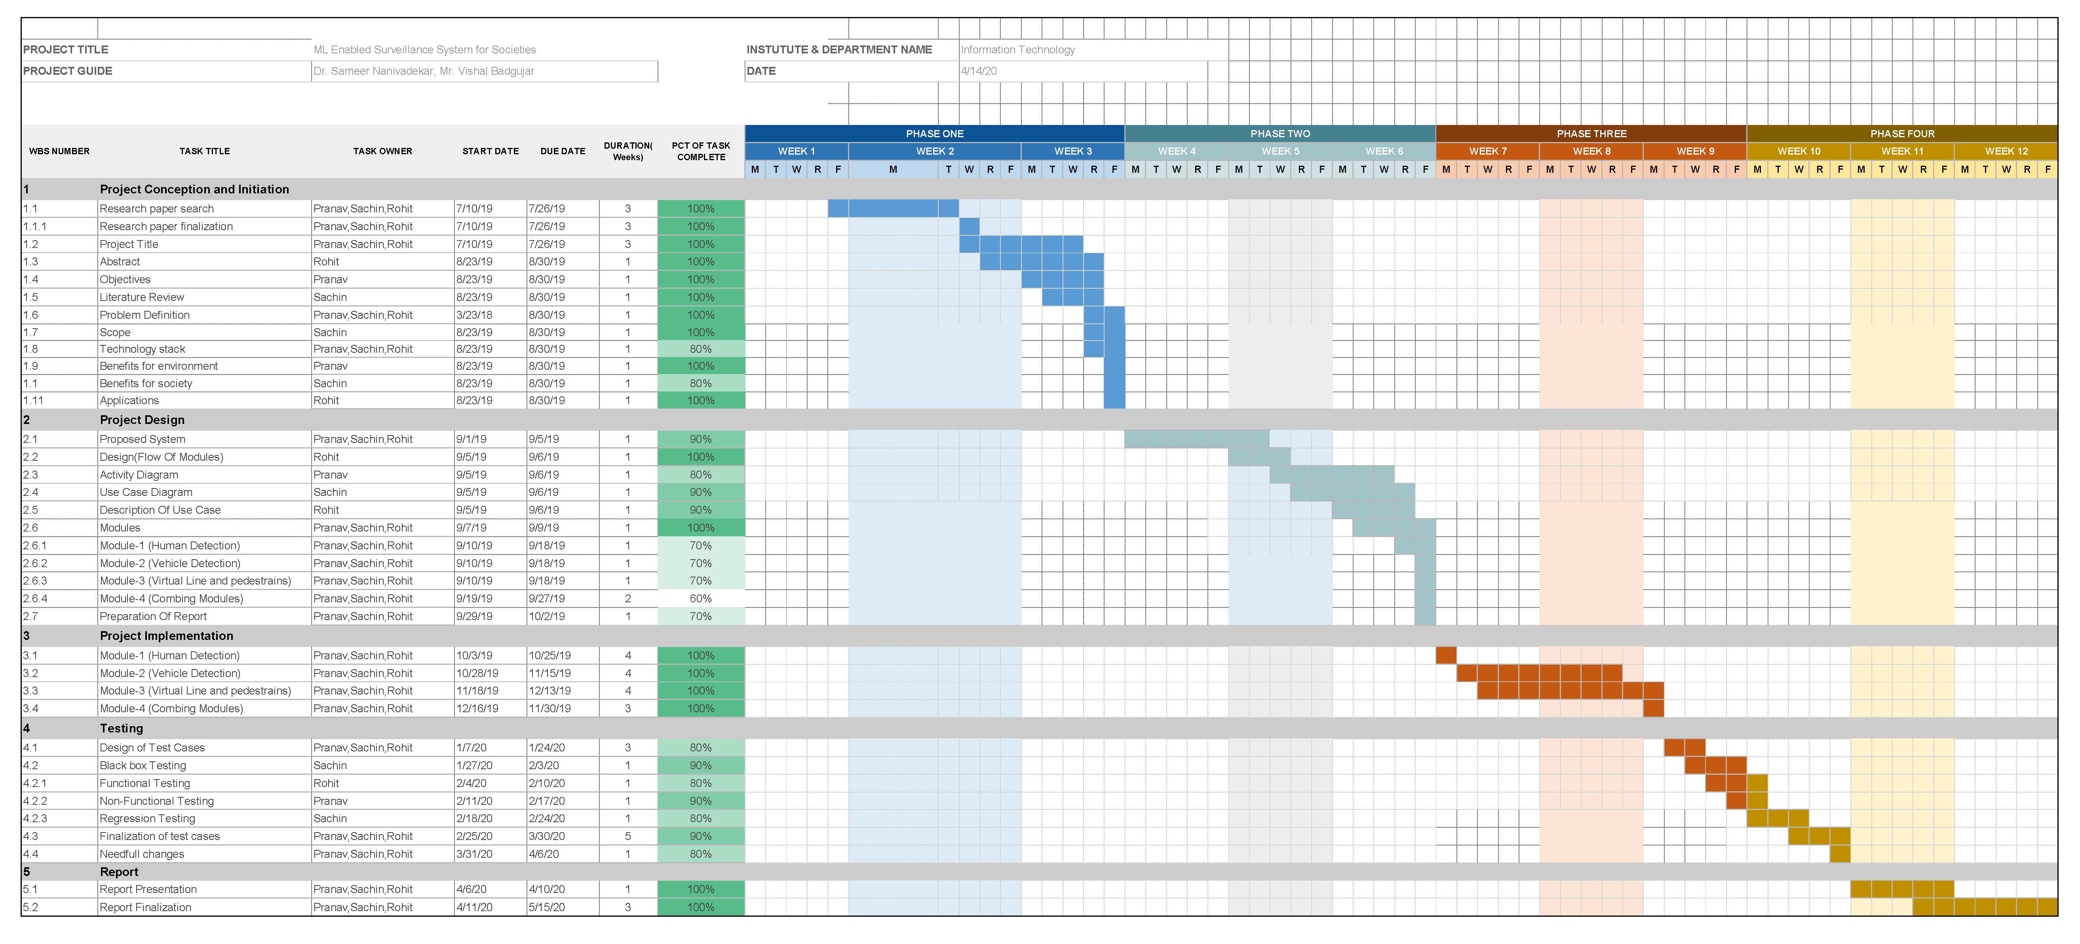
1.8 Project Timeline Chart

Slide 13
2. Project Design

Slide 14
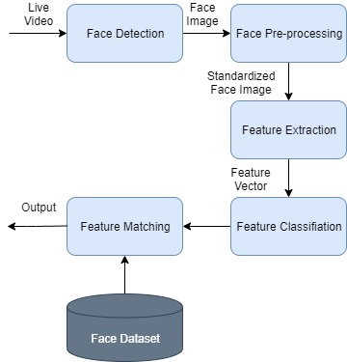
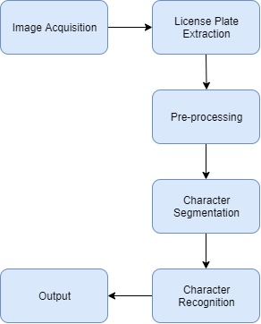
2.1 Proposed System Architecture
Face Detection module
Number Plate Detection module

Slide 15
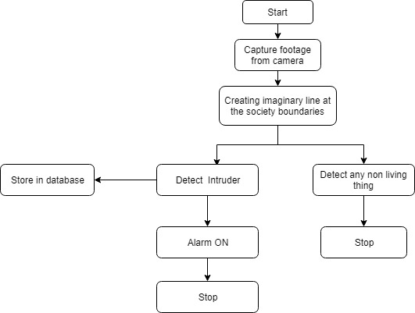
Imaginary Line module

Slide 16
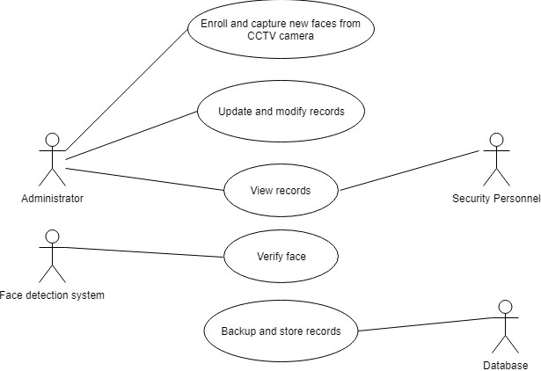
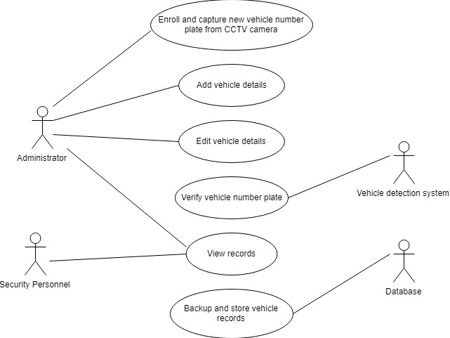
2.2 Use Case diagram
Usecase diagram for face detection
Usecase diagram for vehicle number plate detection

Slide 17
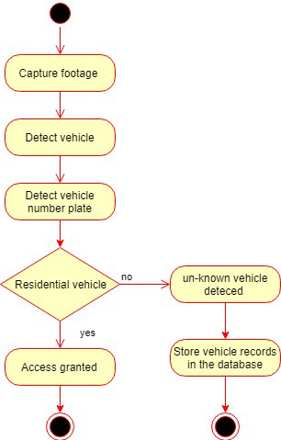
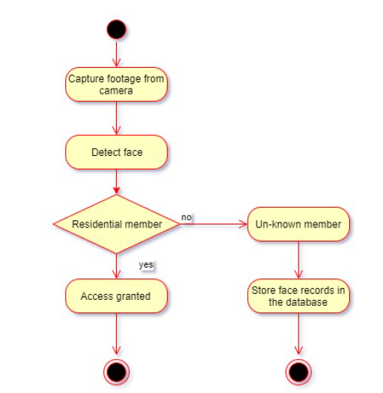
2.3 Activity diagram
Activity diagram for face detection
Activity diagram for vehicle number plate detection

Slide 18
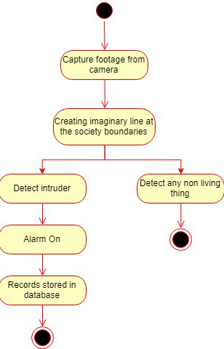
Activity diagram for imaginary line module

Slide 19
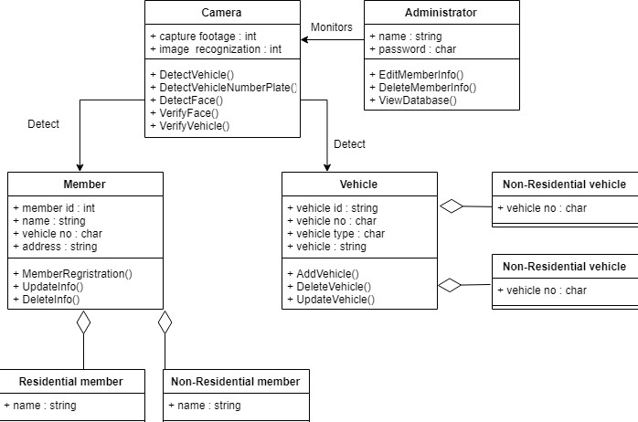
2.4 Class Diagram

Slide 20
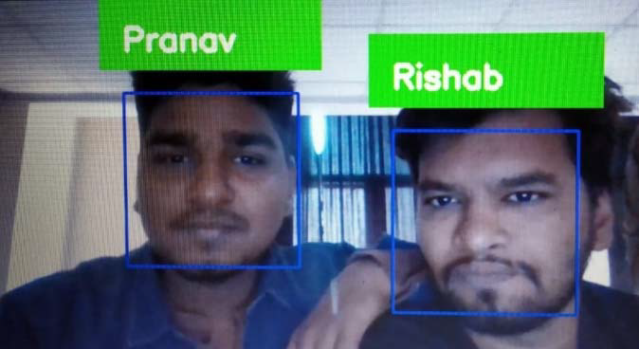
2.5 Results
The output for the face recognition module
The output for human and object detection module
In the above figure, we have used OpenCV3 and KNN classifier to perform face recognition. To build our face recognition module, we have first performed face detection, extract face embedding’s from each face using deep learning, train a face recognition model on the embedding’s, and then finally recognize faces in both images and video streams with OpenCV3.
In the above figure, we have used YOLOv3 model for object detection and human detection. The object detection module is a part of imaginary line/virtual line module. Object detection is a computer vision task that involves both localizing one or more objects within an image and classifies each object in the image. Our model can detects common objects like cup, chair, phone, etc.

Slide 21
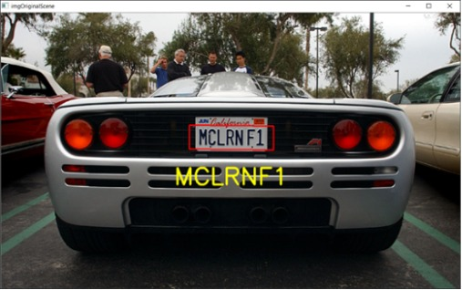
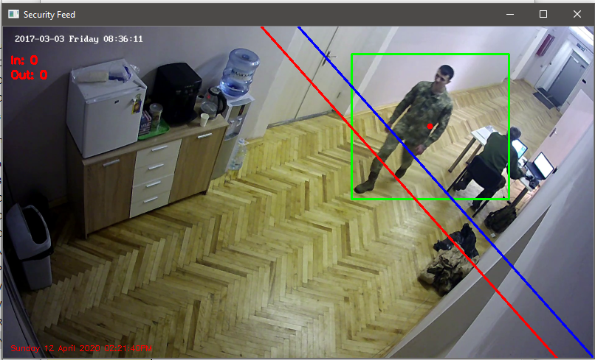
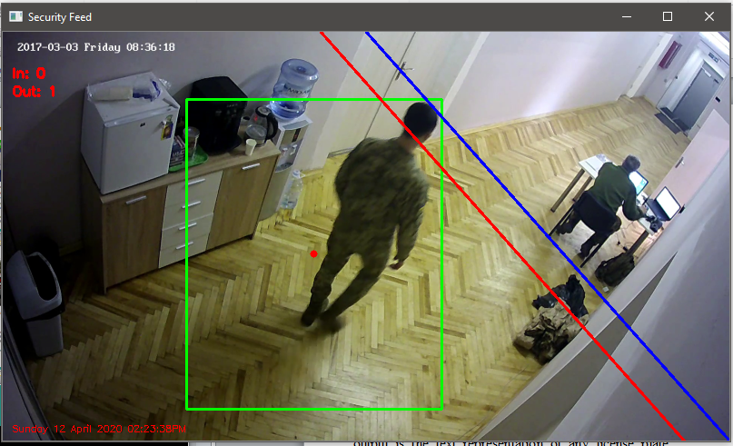
The output for the Vehicle number plate recognition module
Output for Imaginary line module
We have used ANPR/ALPR is an open-source Automatic License Plate Recognition library to perform vehicle number plate recognition. The library analyses images and video streams to identify license plates. The output is the text representation of any license plate characters recognized in the processed image which was shown in figure .
In the above two figures, we have used opencv2 to detect the person and python math function to create the blue and red line. Figure 1 shows that the person is coming IN and figure 2 shows that the person is going out from the imaginary line.

Slide 22
3. Conclusion and Future Scope

Slide 23
In our work, we propose a system for vehicle detection and tracking in real-time. Our system is also used to detect the human face in real-time. This proposed system can be applied in the fields of the society security system and also in the smart vehicle parking system. However, there are limitations in our system. Our system struggles to detect human faces covered with any object such as cloth or any type of mask. Future works will contain the improvement of that.

Slide 24
References
Wang W, Gee T, Price J, et al. Real time multi-vehicle tracking and counting at intersections from a fisheye camera[C]//2015 IEEE Winter Conference on Applications of Computer Vision. IEEE, 2015: 17-24.
H. Saghaei, “Proposal for Automatic License and Number Plate Recognition System for Vehicle Identification,” arXiv preprint arXiv:1610.03341, Oct 2016.
Zhang Quanfa,et al. "Engineering vehicle inspection based on HOG feature and machine learning." Computer system application ,2013:104-107.
Girshick,Ross."Fast R-CNN."IEEE International Conference on Computer VisionIEEE Computer Society, 2015:14401448

Slide 25
Publication
Pranav Chauhan, Sachin Gupta, Rohit Arava, Sameer Nanivadekar, Vishal Badgujar “ML Enabled Surveillance System for Societies.” // Feb 2020 Summer conference on Emerging Trends in Information Technology and Engineering.

Slide 26
Thank You

